Slide 1
CQL Authoring

Slide 2
IDE Plugins
The Atom IDE is sunsetting
The CQL Atom Plugin is sunsetting as a consequence
The Github repository is archived and links are being redirected to the VSCode plugin
Future enhancements will be applied to the VSCode plugin

Slide 3
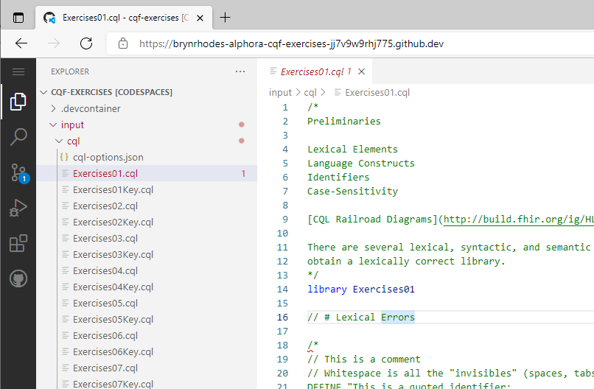
VS Code – Best Editor Ever
https://code.visualstudio.com/
Full-featured IDE
Web and local development
CQL plugin w/
Highlighting
Syntax checking
Ad-hoc evaluation
Test cases
Terminology support

Slide 4
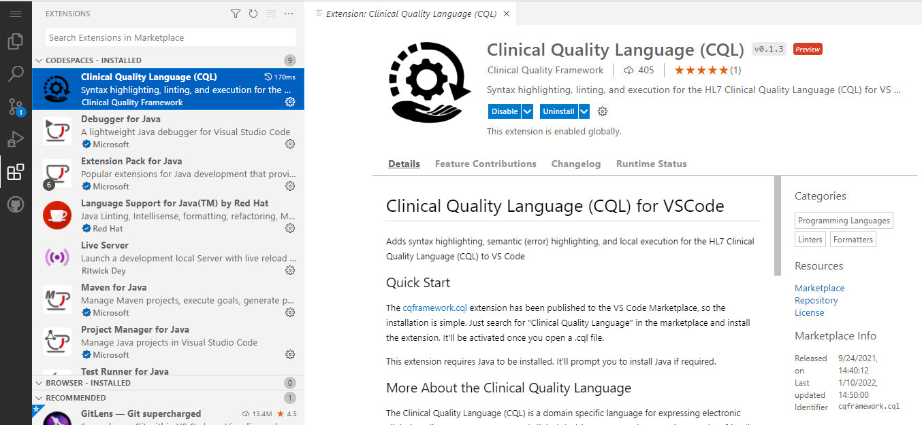
VS Code – Extensions
Extension Identifier: cqframework.cql

Slide 5
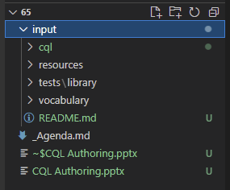
Open a CQL project
CQL project is a folder with the following structure:
Root folder
input folder
cql folder
tests folder
vocabulary folder
Root documents (README.md)
NOTE: This structure is aligned with project structure for FHIR implementation guides

Slide 6
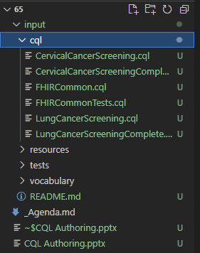
CQL Folder
Contains all source CQL files for the project Only one directory is allowed All CQL files must be in the same directory
Files names must match Library names _exactly_ e.g. <library name>.cql

Slide 7
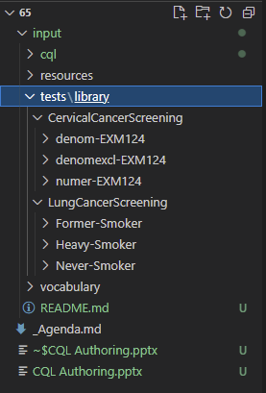
Tests Folder
tests\library – Library test cases (one folder for each library under test)
CervicalCancerScreening library tests One folder for each test case One patient per test case Patient id must match test case folder name _exactly_
LungCancerScreening library tests

Slide 8
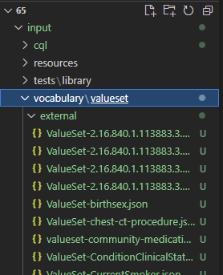
Vocabulary Folder
vocabulary\valueset – All files in this directory, recursively
Use the external folder for valuesets that are not part of your content
Can be one file per ValueSet, or can be bundles

Slide 9
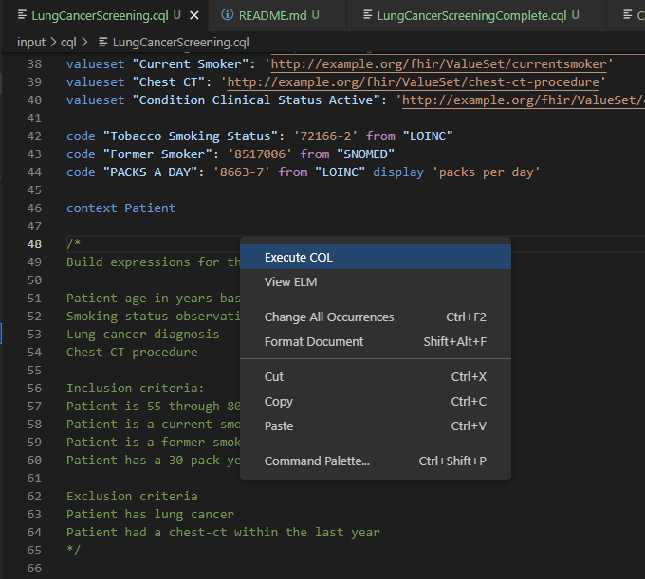
Running Tests
Right-click anywhere in the editor and select “Execute CQL”

Slide 10
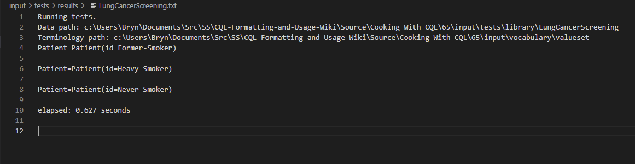
Test Results
New window will appear, open on the results in the “results” folder
Output contains: Data path: This is the path the evaluator is using for test cases
Terminology path: This is the path the evaluator is using for value sets
For each test case, the result of evaluating all expressions in the library with the data for that test case

